Slide 1
ICTW Project Presentation Sanitizing (UV light) Remote Control Robot
Group Number: xyz
Team Members:
Ansh Singh: IMT2020-013
Arun Singh Kushwaha: IMT2020-016
Lucky Kumar: IMT2020-051
Ritik Kumar:IMT2020-080
Submitted To: Dr. Somesh Kumar(Assistant Professor)

Slide 2
Table of Contents
Motivation
Novelty
Sanitizing Remote Control Robot
Components Used
Working and Circuit Diagram
Miscellaneous
Applications in Real life
Future Improvements
Introduction

Slide 3
Introduction
The Sars-COV-2 is responsible for the disease known as COVID-19, which primarily spreads through contaminated surfaces. So to sanitize the surface is the most efficient way to minimize the spreading of COVID – 19. To ease the process of sanitizing, we have come up with the IDEA of SANITIZING RC ROBOT which uses UV light to sanitize a given area. It is faster, cost efficient, toxic free, environmental friendly unlike disinfectant liquids.

Slide 4
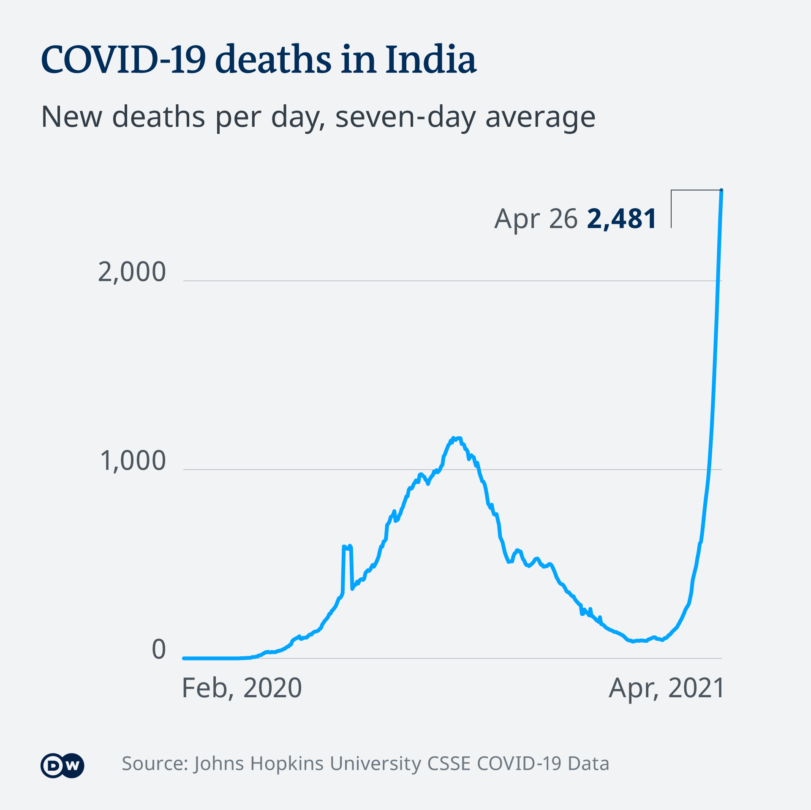
Motivation
The threat of the spread of the virus is not something new, but the recent COVID – 19 pandemic has caused many problems medically, socially, mentally and technologically.
The number of cases and deaths in INDIA due to COVID – 19, are increasing day by day, and to prevent his spread we must maintain utmost cleanliness.
So to do that we must disinfect the surface after touching it, but it is a tedious, time taking, risky process to disinfect the touched surface.
So with the thought of preventing the above points we came up with this idea of Sanitizing Remote Control Robot

Slide 5
01
02
Problem Vs. Solution
Our Project
03
Components
04
Pros Vs Cons
Problem: Sanitization with minimum Contact
Project: Sanitizing (UV Light) Remote Control Robot
Components Used in making of Robot and the Circuit Diagram
Pros and Cons of Using Robots and UV light

Slide 6
01.
Working

Slide 7
Our Sanitizing Robot is an autonomous robotic model that simply means that our robot have some sensors to detect the obstacle and environment. To make the robot autonomous we can use different kinds of sensor like radar, lidar, ultrasonic, IR modules . We choose IR modules because they are cheap and easy to interface with Arduino UNO . We are using UV led to sterilize the surfaces. This robot is very helpful as it is autonomous thus not man force is required to operate the robot. This help to break the chain of infection. The components used are very cheap and are easily available. Basically what our Robot does, it detects obstacle in surrounding and on UV led switch on in that direction and disinfects that area and automatically switches off after the sanitizing is completed. After that based on IR sensor input it turns in appropriate direction such that it doesn’t collide with the obstacles.

Slide 8
02.
Components Used

Slide 9
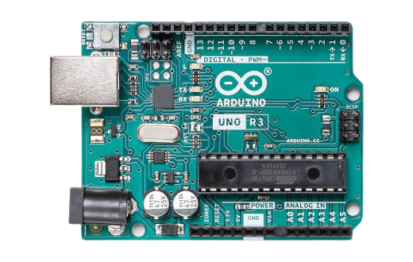
Arduino Uno is a microcontroller board based on the ATmega328P. It has 14 digital input/output pins (of which 6 can be used as PWM outputs), 6 analog inputs, a 16 MHz ceramic resonator (CSTCE16M0V53-R0), a USB connection, a power jack, an ICSP header and a reset button. It contains everything needed to support the microcontroller; simply connect it to a computer with a USB cable or power it with a AC-to-DC adapter or battery to get started
Arduino Uno
Arduino Uno

Slide 10
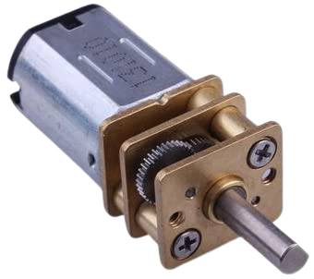
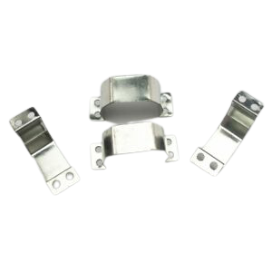
DC Motor
DC Motor is used for the movement of the Robot. We will use N20 DC Motor as it is light weight and capable of producing High Torque.
N20 DC Motor
Motor Bracket
These motor bracket provide easy and secure mounting of the of the DC Motors in the project.
Motor Brackets
Notes:
Do Check the usage of the Motor Bracket Once

Slide 11
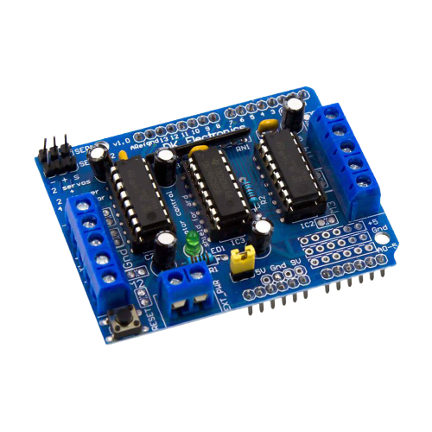
The L293D is a popular 16-Pin Motor Driver IC. As the name suggests it is mainly used to drive motors. A single L293D IC is capable of running two DC Motors at the same time; also the direction of these two motors can be controlled independently. Using this L293D motor driver IC is very simple. The IC works on the principle of Half H-Bridge. H bridge is a set up which is used to run motors both in clock wise and anti clockwise direction.
Motor Driver
L293D Motor Driver Board

Slide 12
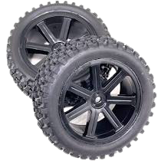
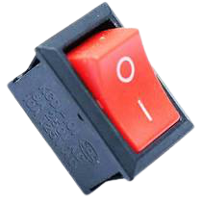
Wheel
Wheel is required for the smooth movement of the robot on the surface.
Wheel
Switch
The switch is used for the on / off the robot so that we can use remote to control the robot.
Switch
Notes:
Do Check the usage of the Motor Bracket Once

Slide 13
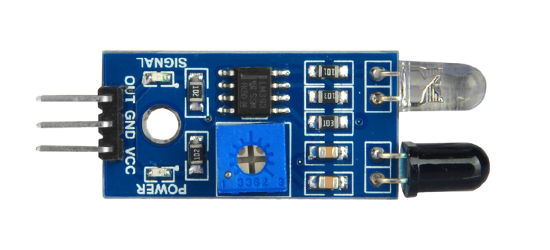
An infrared (IR) sensor is an electronic device that measures and detects infrared radiation in its surrounding environment. IR is invisible to the human eye, as its wavelength is longer than that of visible light. Anything that emits heat gives off infrared radiation. Active infrared sensors both emit and detect infrared radiation. Active IR sensors have two parts: a light emitting diode (LED) and a receiver. When an object comes close to the sensor, The infrared light from the LED reflects off of the object and is detected by the receiver.
Infrared Sensor
Infrared Sensor

Slide 14
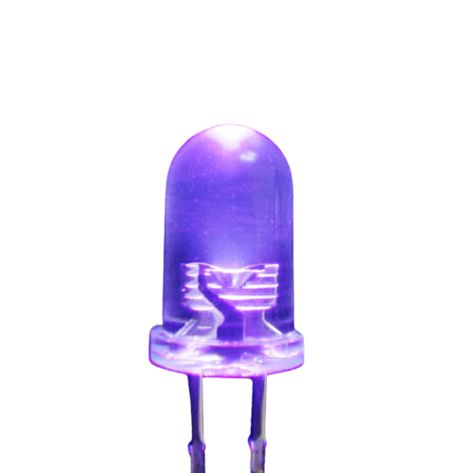
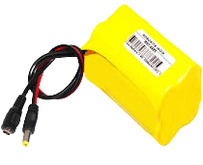
UV Light LED
UV light is the most important component of our project. It is used to destroy the bacteria, viruses and parasites from the surfaces, room.
UV Light LED
Lithium Ion Battery
Another important component of the Robot, without the battery we will not be able to operate the robot as a result we will not be able to sanitize the given place.
Battery (7.42V)
Notes:
Do Check the usage of the Motor Bracket Once

Slide 15
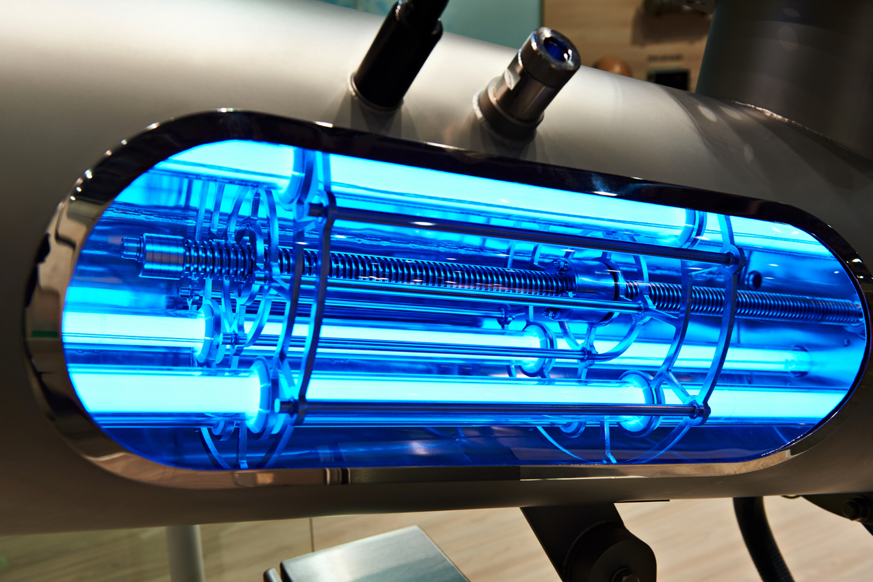
What is UV light ?
Ultraviolet light is a type of electromagnetic radiation. Electromagnetic radiation comes from the sun and transmitted in waves or particles at different wavelengths and frequencies. This broad range of wavelengths is known as the electromagnetic (EM) spectrum. Ultraviolet (UV) light falls in the range of the EM spectrum between visible light and X-rays.
Why UV light ? ?
Bio-organisms such as bacteria, spores and viruses are known to be deactivated when exposed to UV-C light irradiation. UV light has been shown to destroy the RNA in viruses and can reduce the transmission of microbes, which can remain active on surfaces for long periods of time. Ultraviolet light destroys the genetic material in pathogens—DNA in bacteria and fungi, RNA in viruses—preventing them from reproducing.

Slide 16
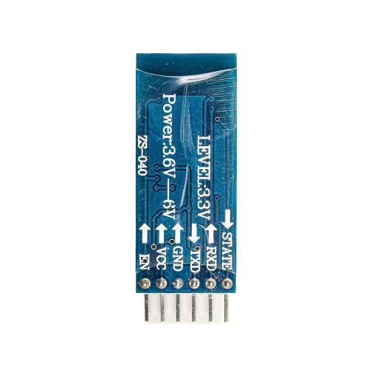
The HC-05 is a very cool module which can add two-way (full-duplex) wireless functionality to your projects. You can use this module to communicate between two microcontrollers like Arduino or communicate with any device with Bluetooth functionality like a Phone or Laptop. We can also configure the default values of the module by using the command mode. So if you looking for a Wireless module that could transfer data from your computer or mobile phone to microcontroller or vice versa then this module might be the right choice for you
HC-05 Bluetooth Module
HC-05 Bluetooth Module

Slide 17
Connections And Coding
03.

Slide 18
Why to Use Motor Driver IC ? ? Before getting answer of above question Let’s have a brief idea of working of motor. We need our robot to move in different direction. This can be done by changing the polarity of right and left motor. Thing to note here is motor move in anticlockwise direction when positive terminal is at high phase and negative is at low phase. Similarly motor move in clockwise direction when polarity are reverse. To change the polarity of the motor we are using a automatic system. To achieve this purpose we using a Arduino. But wait we have a problem, we can’t use Arduino directly to control motors.
Understanding Connections

Slide 19
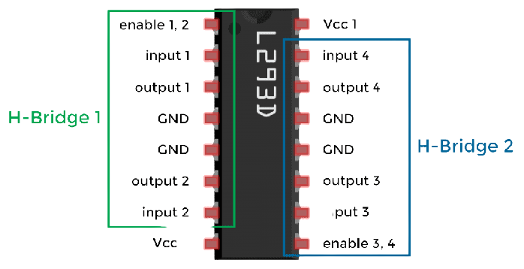
BUT WHY ??????????????????????
The reason is simple, we know Arduino output of is 5V But motor operate on 9V/12V. Thus Arduino can’t directly control motor as limited to work on 5V. HERE comes L293D motor diver IC in play. Basically what L293D does that it takes 5V signal from Arduino and accordingly provide 9V/12V power to motor and controls it. This make L293D IC prime component for every project dealing with motors. But how does this small IC is able to provide power to motor and controls it. To Know this we need look at the working of the IC.
L293D Motor Driver IC

Slide 20
Connecting L293D IC
The L293D is a 16 pin IC, with eight pins, on each side, to controlling of two DC motor simultaneously. There are 4 INPUT pins, 4 OUTPUT pins and 2 ENABLE pin for each motor.
Connections with Arduino
1. Module 5V (VCC)(16) – Arduino 5V.
2. Module GND(13) – Arduino GND.
3. Input 1(2) – Arduino D2.
4.Output 1(3) – Motor Left ve.
5. Input 2(7) – Arduino D3.
6.Output 2(6) – Motor Left -ve
7. Input 3(15) – Arduino D4.
8.Output 3(14) – Motor Right +ve
9. Input4(10) – Arduino D5.
10.Output 4(11) – Motor Right -ve
11. Module VSS power terminal(8)- External power source of 9V.
12.Enable ½ (1) – D11
13.Enable ¾ (9) – D10

Slide 21
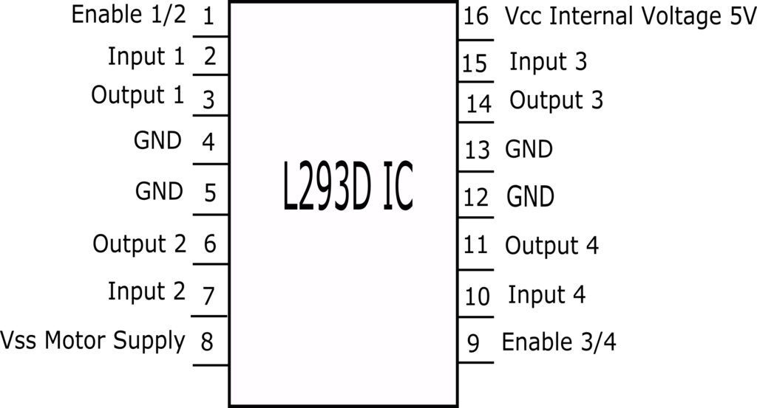

Slide 22
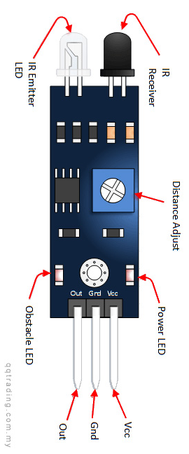
Connecting the IR Sensor
Working
IR Sensor Module work in reverse logic that is it produce low signal when obstacle is present and high signal when obstacle is not present.
In the robot there are 3-IR Sensor, in left, right and forward direction. Each IR module has 3 pins Vcc , GND, Out. Vcc and GND of each IR sensor is connected to 5v and GND of Arduino respectively.
Out of each IR sensor is connected to different digital pins of Arduino.
Left IR Sensor –D6, Forward IR Sensor – D7, Right IR Sensor – D8

Slide 23
Connecting Motors and LED
We have two motors each having two terminals positive and negative . They are connected to the IC . IC pins connection are shown in left side.
In the project we are using three UV Led, each for left, right and forward direction. When ever IR-Sensor detects an obstacle the respectively Led glows for 30 sec and disinfects the area.
LEFT Led – D9
RIGHT Led – D12
FORWARD Led – D13

Slide 24
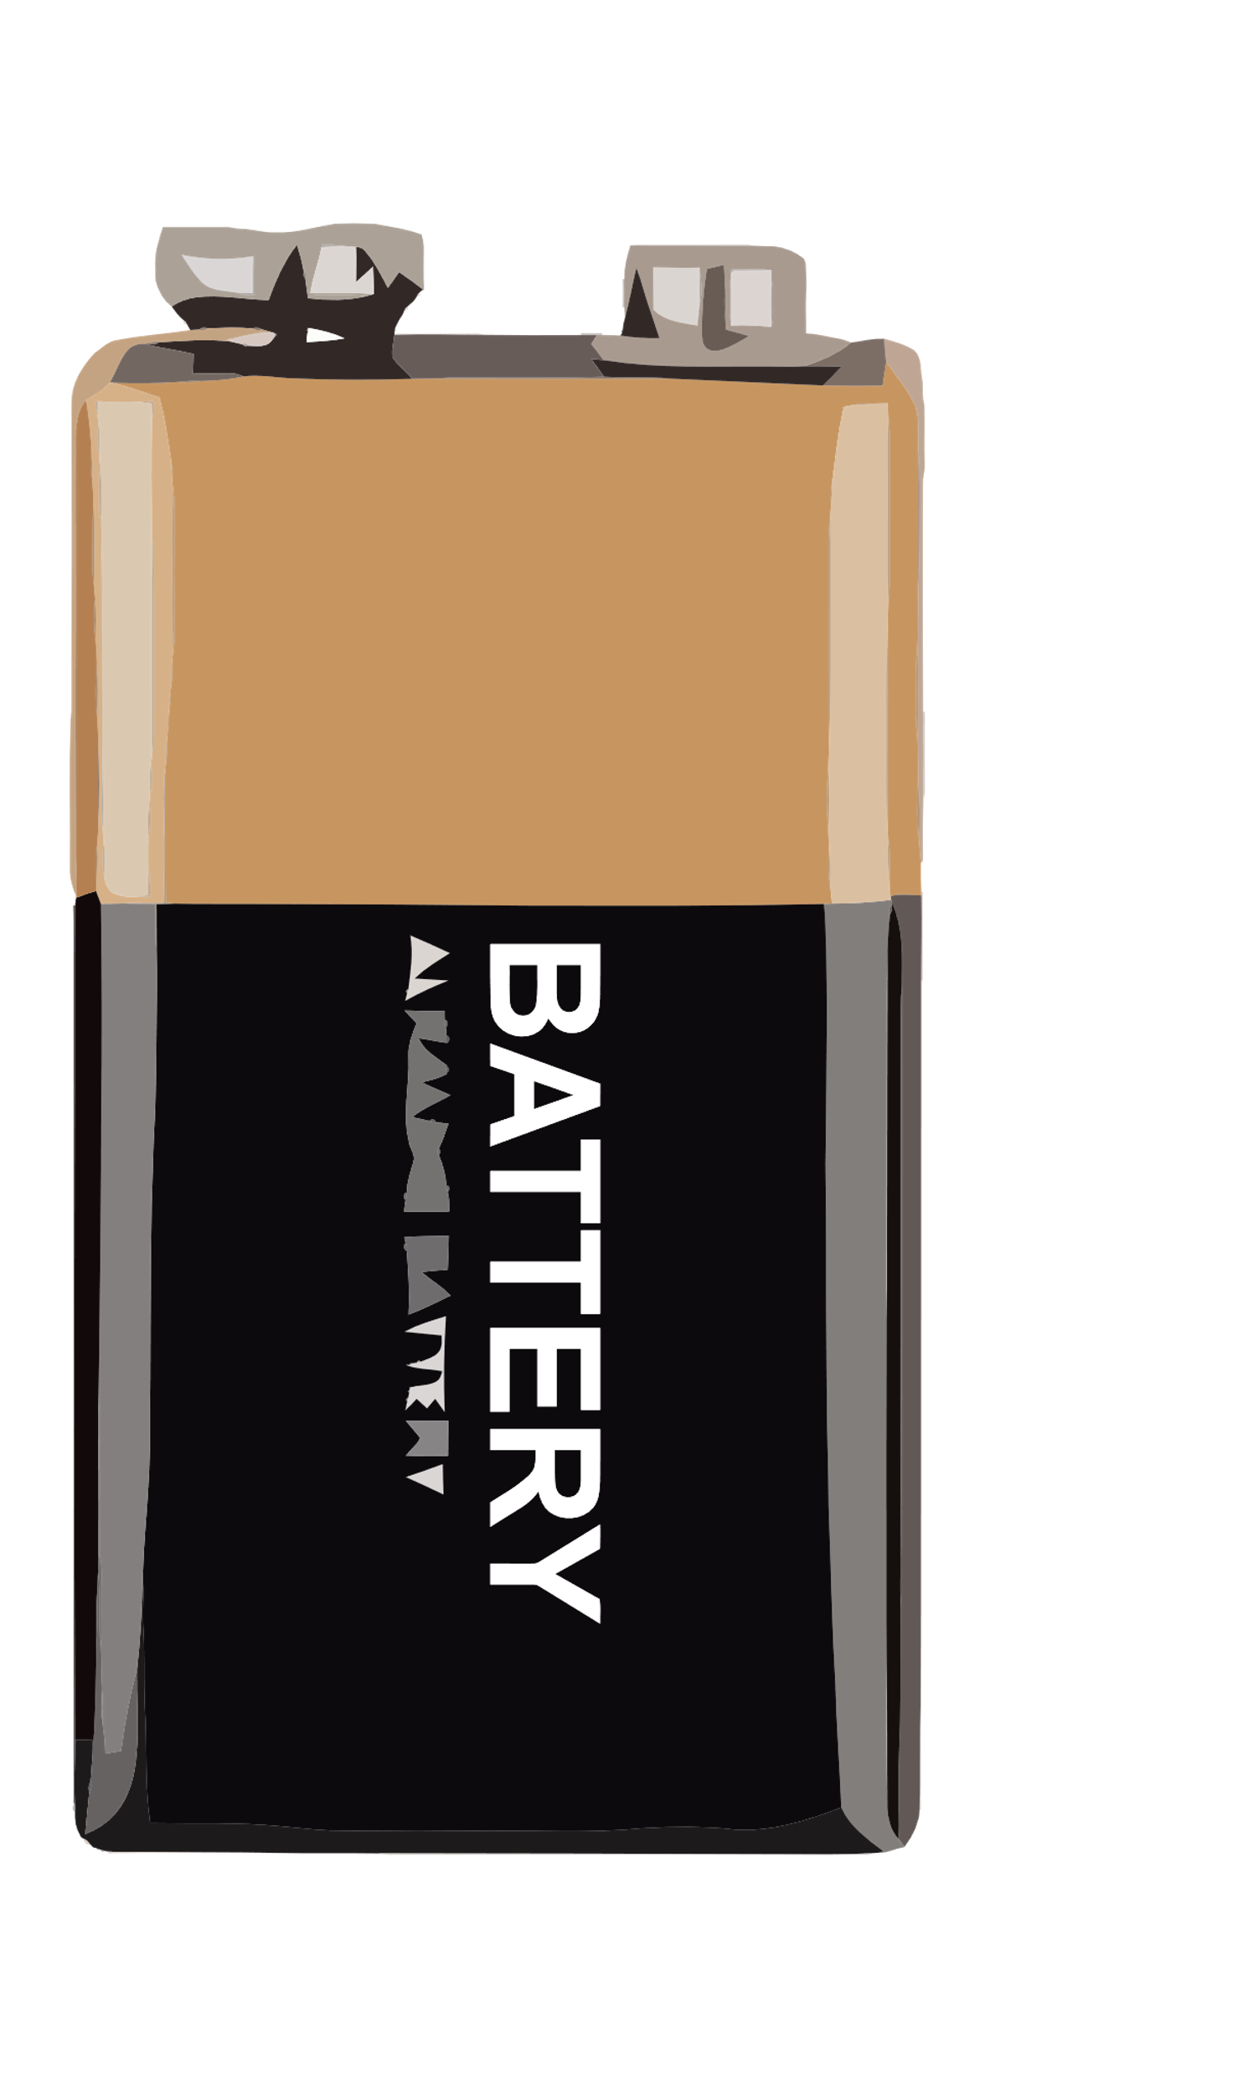
Connecting the Battery
The Battery Connections are very simple. The positive terminal of the battery is connected to Vss Motor Supply of IC pin 8.
The Negative terminal is connected to GND pin of Arduino

Slide 25
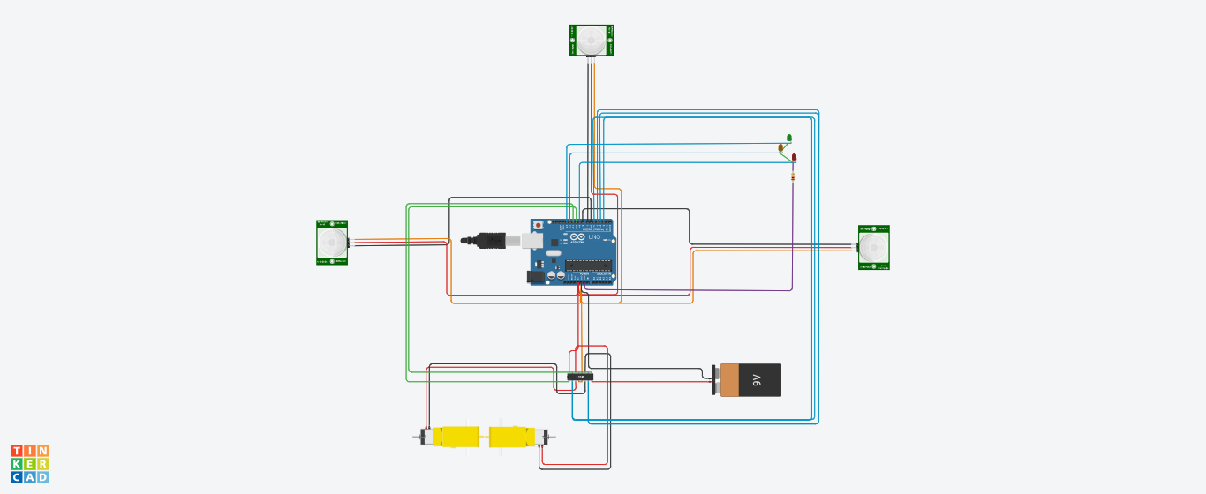

Slide 26
HURRAY!!
Our circuit connection is completed
DESIGN LINK
Let’s Move to Coding Part

Slide 27
Writing The Logic
Let’s first Define all the pins connected to Arduino
#define LEFT 6
#define FORWARD 7
#define RIGHT 8
#define LEFTLED 9
#define RIGHTLED 12
#define FORWARDLED 13
#define MOTORLEFTPOS 2
#define MOTORLEFTNEG 3
#define MOTORRIGHTPOS 4
#define MOTORRIGHTNEG 5
Every Components Connected to Arduino digital pins are defined above.

Slide 28
Now Let’s define nature of each digital pins, whether the pin is input or
output. This part is called void setup.
void setup()
{
pinMode(10, OUTPUT);
pinMode(11, OUTPUT);
pinMode(LEFT, INPUT);
pinMode(FORWARD, INPUT);
pinMode(RIGHT, INPUT);
pinMode(LEFTLED, OUTPUT);
pinMode(RIGHTLED, OUTPUT);
pinMode(LEFTLED, OUTPUT);
pinMode(MOTORLEFTPOS, OUTPUT);
pinMode(MOTORLEFTNEG, OUTPUT);
pinMode(MOTORRIGHTPOS, OUTPUT);
pinMode(MOTORRIGHTNEG, OUTPUT);
Serial.begin(9600);
}

Slide 29
Now lets define condition for motor movements.
void stop(){
digitalWrite(MOTORLEFTPOS, LOW);
digitalWrite(MOTORLEFTNEG, LOW);
digitalWrite(MOTORRIGHTNEG, LOW);
digitalWrite(MOTORRIGHTPOS, LOW);
}
void turnRight() {
digitalWrite(MOTORLEFTPOS, HIGH);
digitalWrite(MOTORLEFTNEG, LOW);
digitalWrite(MOTORRIGHTNEG, LOW);
digitalWrite(MOTORRIGHTPOS, HIGH);
}
void forward() {
digitalWrite(MOTORLEFTPOS, HIGH);
digitalWrite(MOTORLEFTNEG, LOW);
digitalWrite(MOTORRIGHTNEG, HIGH);
digitalWrite(MOTORRIGHTPOS, LOW);
}
void softLeft() {
digitalWrite(MOTORLEFTPOS, LOW);
digitalWrite(MOTORLEFTNEG, LOW);
digitalWrite(MOTORRIGHTNEG, HIGH);
digitalWrite(MOTORRIGHTPOS, LOW);
}
void softRight() {
digitalWrite(MOTORLEFTPOS, HIGH);
digitalWrite(MOTORLEFTNEG, LOW);
digitalWrite(MOTORRIGHTNEG, LOW);
digitalWrite(MOTORRIGHTPOS, LOW);
}
void turnLeft() {
digitalWrite(MOTORLEFTPOS, LOW);
digitalWrite(MOTORLEFTNEG, HIGH);
digitalWrite(MOTORRIGHTNEG, HIGH);
digitalWrite(MOTORRIGHTPOS, LOW);
}

Slide 30
Now Code the important part of the code that is loop function.
firstly lets switch the left and right part of the IC. We can use digital
write to set D10 and D11 to high voltage.
Now Take the reading of the IR sensor module using digital read .
Now switch on the Led based on above result. Like if obstacle is in left side
then Left IR sensor will have high value. So we can provide high value at left
led or pin D9 and then delay the robot for 30 sec so that it can sanitize
that area.
digitalWrite(10, HIGH);
digitalWrite(11, HIGH);
bool a = digitalRead(LEFT);
bool b = digitalRead(RIGHT);
bool c = digitalRead(FORWARD);
if(a==0){digitalWrite(LEFTLED,HIGH);stop();}
if(b==0){digitalWrite(RIGHTLED,HIGH);stop();}
if(c==0){digitalWrite(FORWARDLED,HIGH);stop();}
if(a==0||b==0||c==1)delay(30000);

Slide 31
Now after our motor has sanitized the area we have to ensure that our robot doesn’t collide with the obstacle.
If obstacle is in left, left led switches on and after 30 sec we will call turnRight function to turn our robot to right. Using Permutation and Combination we have total 8 cases of the IR Sensor output.
if ((a==0)&&(c==1)&&(b==0)){forward(); Serial.println("Robo Moving Forward"); }
if ((a==1)&&(c==1)&&(b==1)){forward(); Serial.println("Robo Moving Forward");}
if ((a==0)&&(c==1)&&(b==1)){softRight();Serial.println("Robo Moving softRight"); }
if ((a==0)&&(c==0)&&(b==1)){turnRight(); Serial.println("Robo Moving Right"); }
if ((a==1)&&(c==1)&&(b==0)){softLeft(); Serial.println("Robo Moving softLeft");}
if ((a==1)&&(c==0)&&(b==0)){turnLeft(); Serial.println("Robo Moving Left"); }
if ((a==1)&&(c==0)&&(b==1)){turnLeft(); Serial.println("Robo Moving Left"); }
if ((a==0)&&(c==0)&&(b==0)){turnLeft(); Serial.println("Robo Moving Left");}

Slide 32
We Are Finished With Coding Part …….
https://github.com/arun-kushwaha04/ICTW/tree/main/Code/Logic.txt

Slide 33
Applications in Real Life
One-time cost (No need to refill alcohol or chlorine liquid).
Can be used to disinfect surfaces, medical suits, medical masks, and other medical equipment.
Reduce the disinfection time by 60% when compared to liquid-based disinfection methods.
Ability to use for environments with electronic equipment.
One operator can cover a large area.
It has been proven by many institute that the disinfection rate of this type of robot is 99.9997% of germs and it is also capable of killing CORONA VIRUS

Slide 34
Resources

